Slide 1
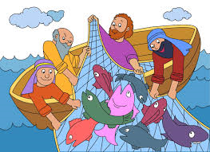
Follow Me, Follow Me

Slide 2
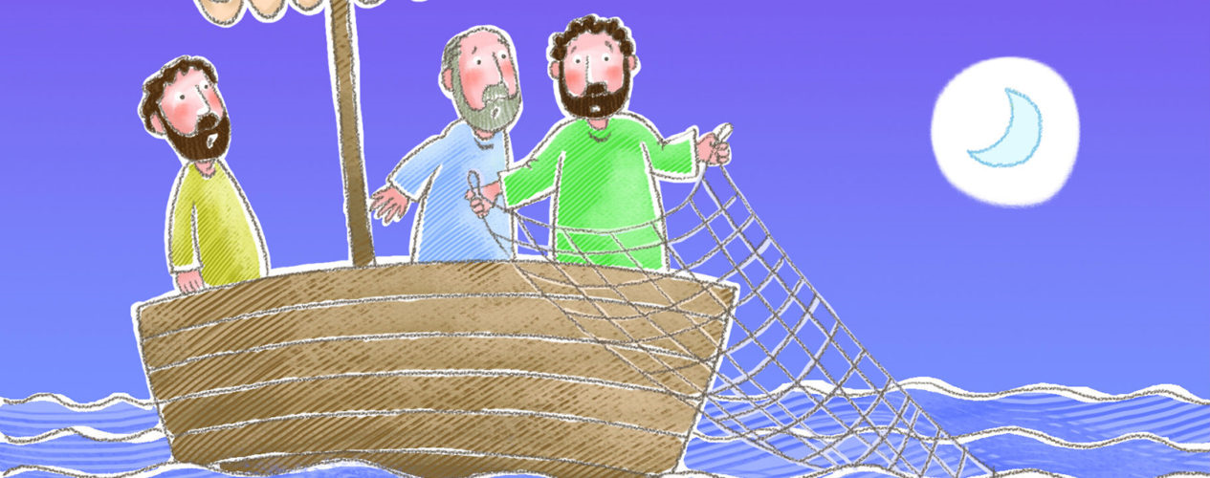
Chorus:
Follow me, follow me, leave your home and family,
Leave your fishing nets and boats upon the shore.
Leave the seed that you have sown, leave the crops that you have grown, leave the people you have known and follow me

Slide 3
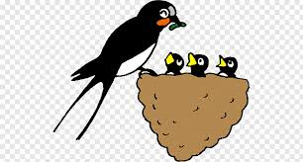
1. The foxes have their holes,
and the swallows have their nests,
but the son of man
has no place to lay down.
I do not offer comfort,
I do not offer wealth,
but in me will all happiness be found.

Slide 4
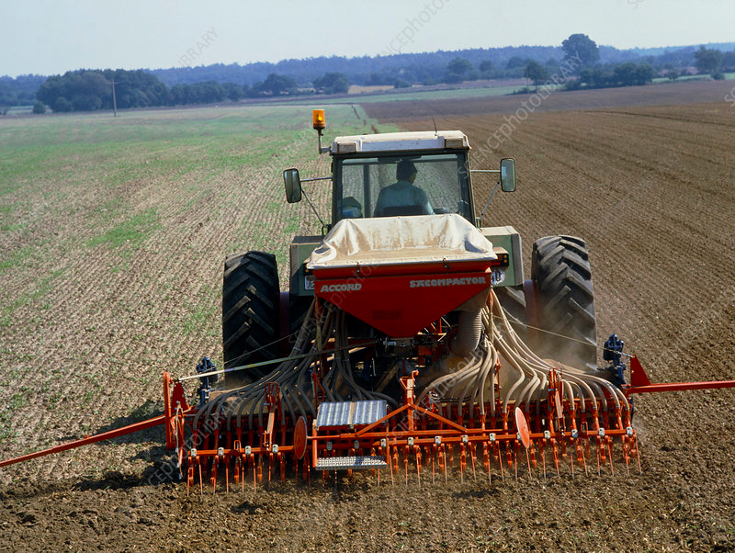
Chorus:
Follow me, follow me, leave your home and family,
Leave your fishing nets and boats upon the shore.
Leave the seed that you have sown, leave the crops that you have grown, leave the people you have known and follow me.

Slide 5
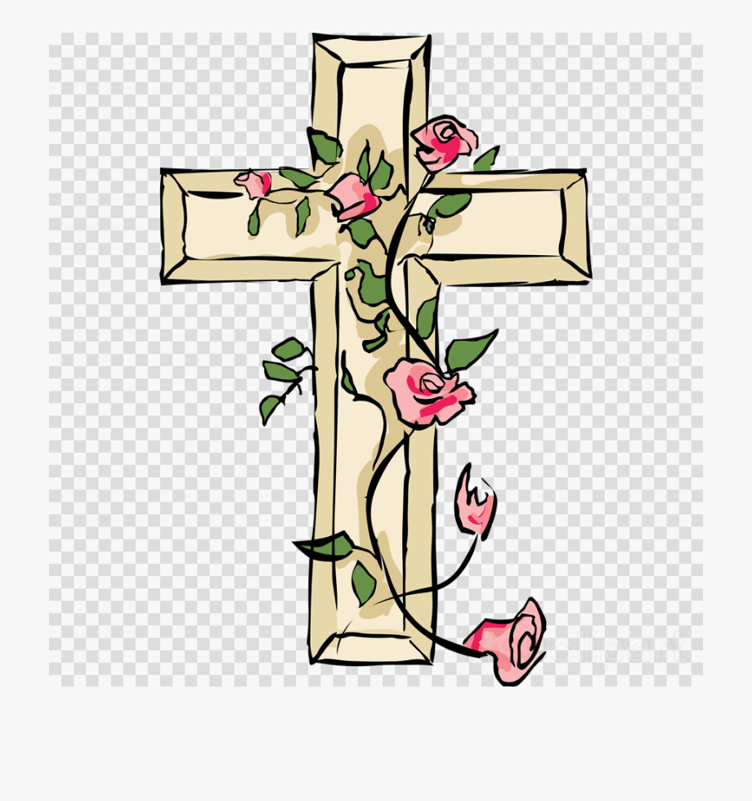
2. If you would follow me,
you must leave old ways behind.
You must take my cross
and follow on my path.
You may be far from loved ones,
you may be far from home,
but my father will welcome you at last.

Slide 6
Chorus:
Follow me, follow me, leave your home and family,
Leave your fishing nets and boats upon the shore.
Leave the seed that you have sown, leave and follow me. the crops that you have grown, leave the people you have known and follow me

Slide 7
3. Although I go away
you will never be alone.
for the spirit will be
there to comfort you.
Though all of you may scatter,
each follow his own path,
still the spirit of love will lead you home.

Slide 8
Chorus:
Follow me, follow me, leave your home and family,
Leave your fishing nets and boats upon the shore.
Leave the seed that you have sown, leave the crops that you have grown, leave the people you have known
and follow me

